Slide 1
Rockbuster Stealth: Data Analysis Project
By: Priya Agrawal
Tableau link: https://public.tableau.com/app/profile/priya.agrawal4103/viz/RockbusterStealthOnlineVideoServiceLaunchStrategyStoryboard/Story1?publish=yes

Slide 2
Purpose
Rockbuster Stealth is looking to launch an online video rental service to maintain competition with streaming services like Amazon Prime and Netflix.
Data analysis was conducted to assist with the launch strategy for Rockbuster’s new online video rental service.

Slide 3
Business questions and analysis
The following questions asked by the Rockbuster Stealth Management Board guided the analysis:
Which movies contributed the most/least to revenue gain?
What was the average rental duration for all videos?
Which countries are Rockbuster customers based in?
Where are customers with a high lifetime value based?
Do sales figures vary between geographic regions?

Slide 4
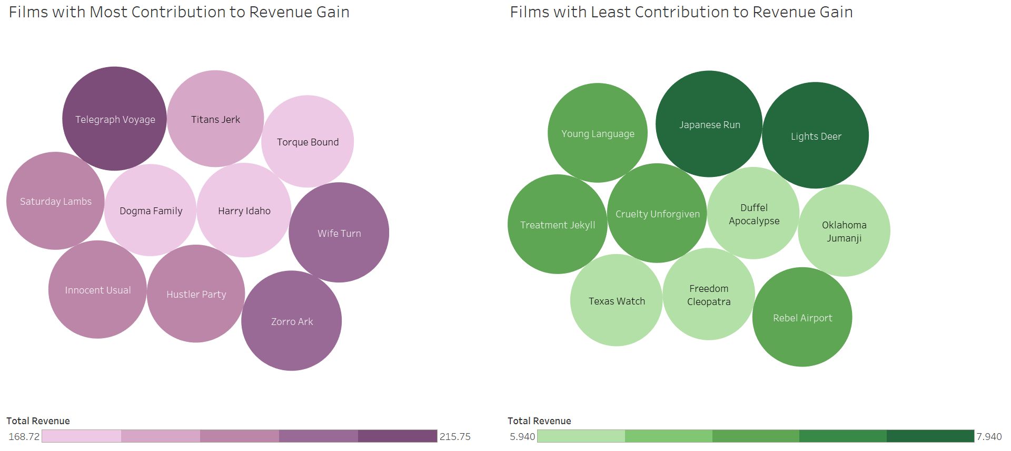
Highest and lowest revenue-generating films
There is a significant difference between both groups in terms of the revenue generated.

Slide 5
Film rental statistics
Rental Duration
Minimum: 3 days
Maximum: 7 days
Average: 5 days
Rental Rate
Minimum: $0.99
Maximum: $4.99
Average: $2.98
Film Length
Minimum: 46 minutes
Maximum: 185 minutes
Average: 115 minutes
Replacement Cost
Minimum: $9.99
Maximum: $29.99
Average: $19.98
Rockbuster’s film inventory consists of 1000 films, all of which were released in 2006.
More films in the inventory are rated PG-13 than any other rating.

Slide 6
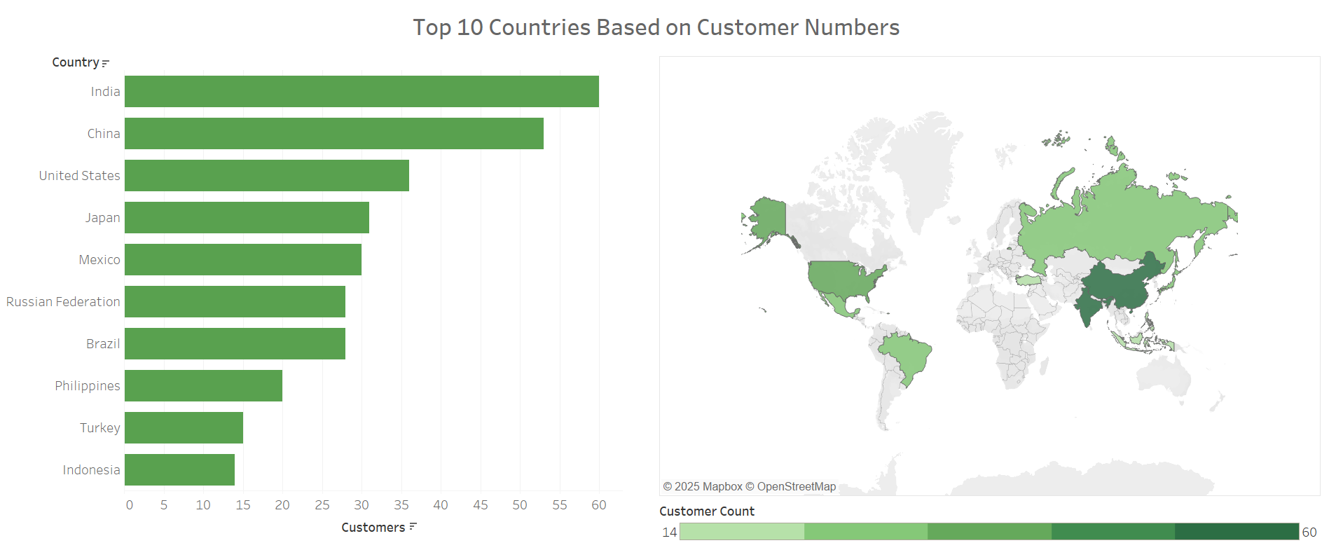
Top countries
Rockbuster’s customers are based in many countries around the world, with India and China having the largest numbers of customers.

Slide 7
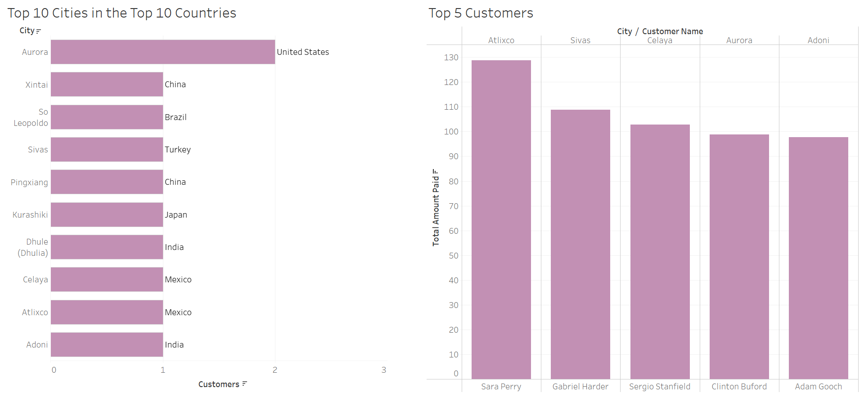
Top customer locations
The majority of Rockbuster’s customers were obtained on February 14, 2006 and the most popular store is store 1.

Slide 8
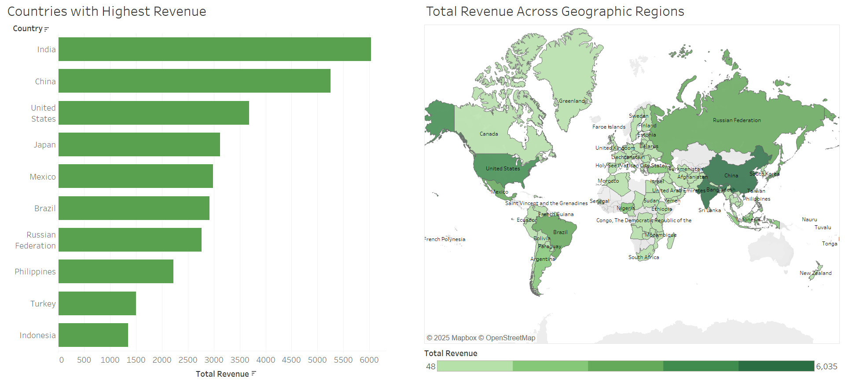
Sales across geographic regions
Sales vary across geographic regions with Asia, North America, and South America having the highest sales.

Slide 9
Recommendations
Rockbuster can remove films from their inventory that do not generate much in revenue, such as the ten lowest revenue-generating films.
Marketing funding, campaigns, and resources for the new online video rental service can be focused on the countries that have the most customers and generate the most revenue such as India, China, United States, Japan, Mexico, etc.
The online video rental service can first be launched in India, China, and the United States since these countries have the most customers and highest sales.

